Slide 1



Slide 2
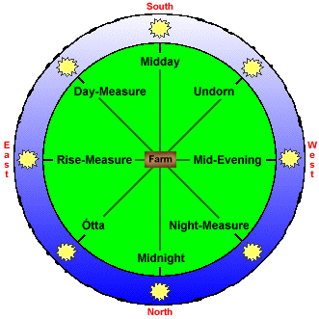

How was the time calculated in ancient days?

Slide 3
Who Made the First Calendar?
Historians believe timekeeping goes as far back as the Neolithic period, but actual calendars weren’t around until the Bronze Age in 3100 BC. The Sumerians in Mesopotamia made the very first calendar, which divided a year into 12 lunar months, each consisting of 29 or 30 days.
The Sumerian calendar was very different from the one we use today. Here’s how:
One year had 360 days
A day was divided into 12 hours – 6 “daytime” hours and 6 “nighttime” hours
Wet and dry seasons were observed Each month had 29
There were no weeks
or 30 days
Holy days were observed on the 7th and 15th of the month
An extra month was added every four years

Slide 4
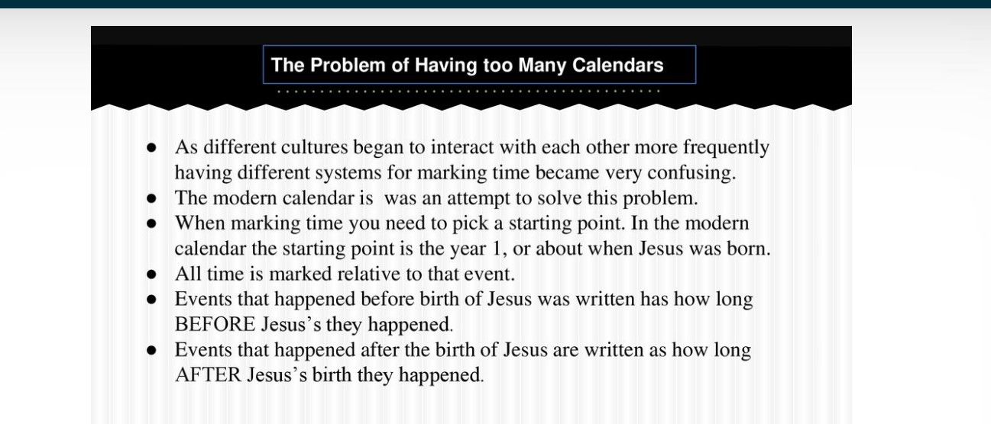
Calendars We use /Social/N Karunambigai//SNS ACADEMY

Slide 5
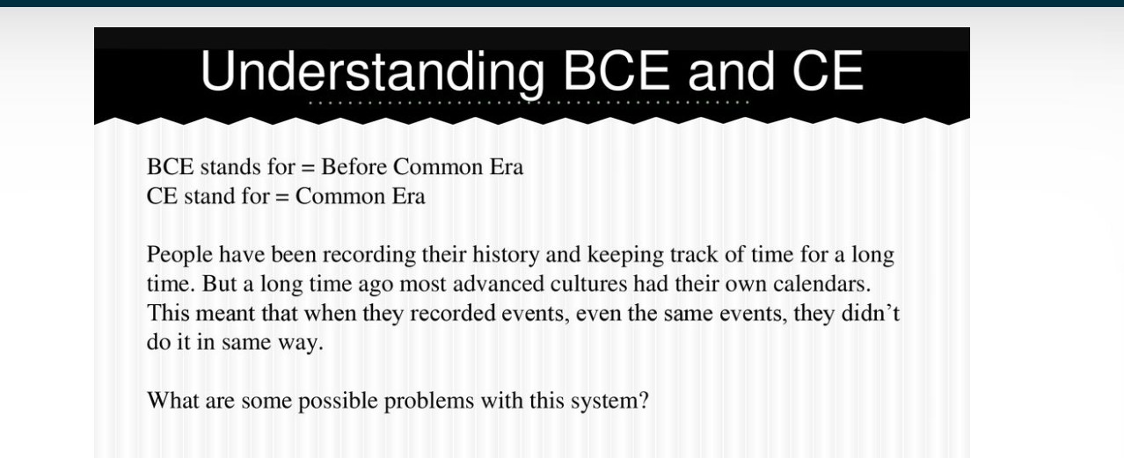

Slide 6
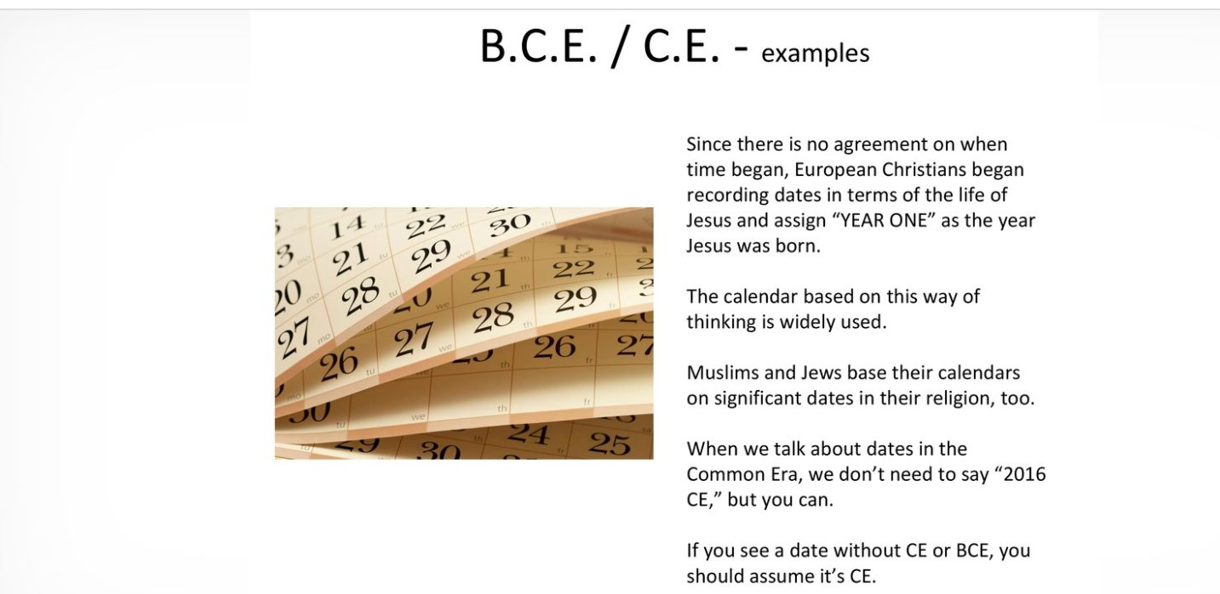

Slide 7
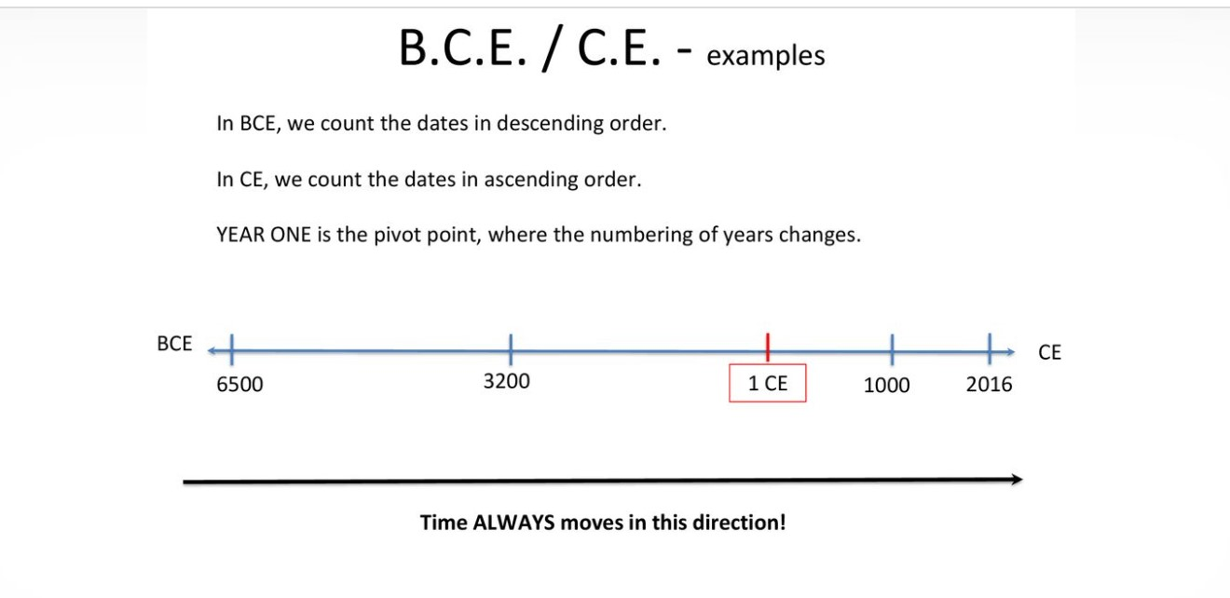
Calendars We use/Karunambigai/Social/SNS ACADEMY

Slide 8
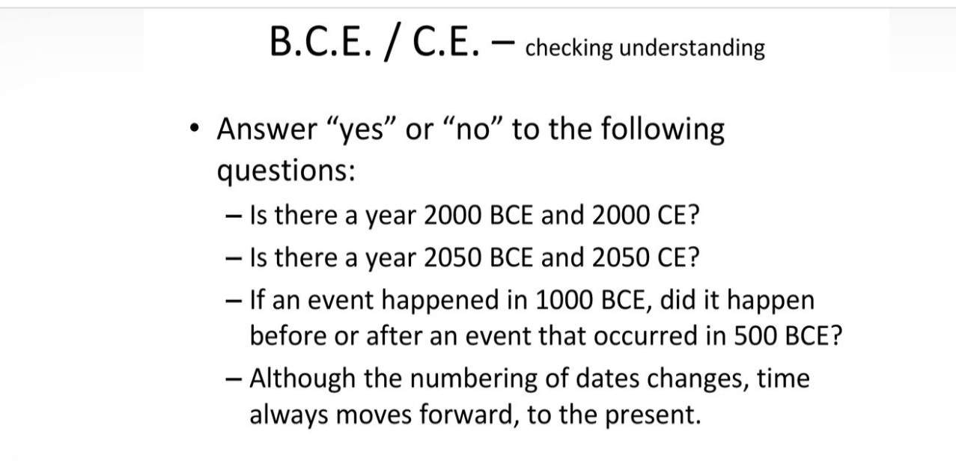

Slide 9
Calendars we use
https://youtu.be/5SJvSNGz0Zw

Slide 10


